Slide 1
ILITEK-2312 Adjusting Manual

Slide 2
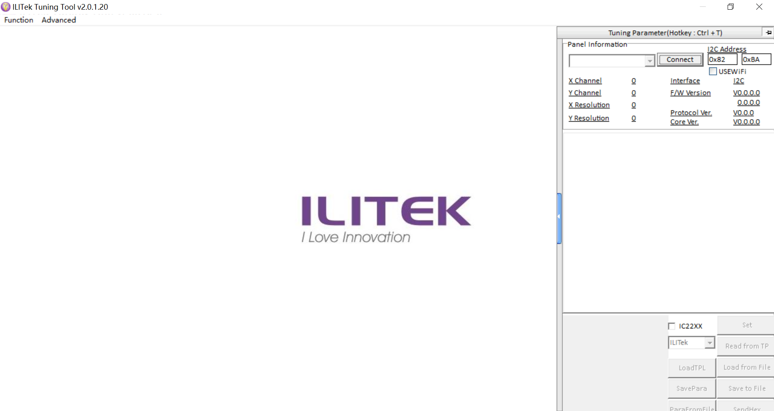
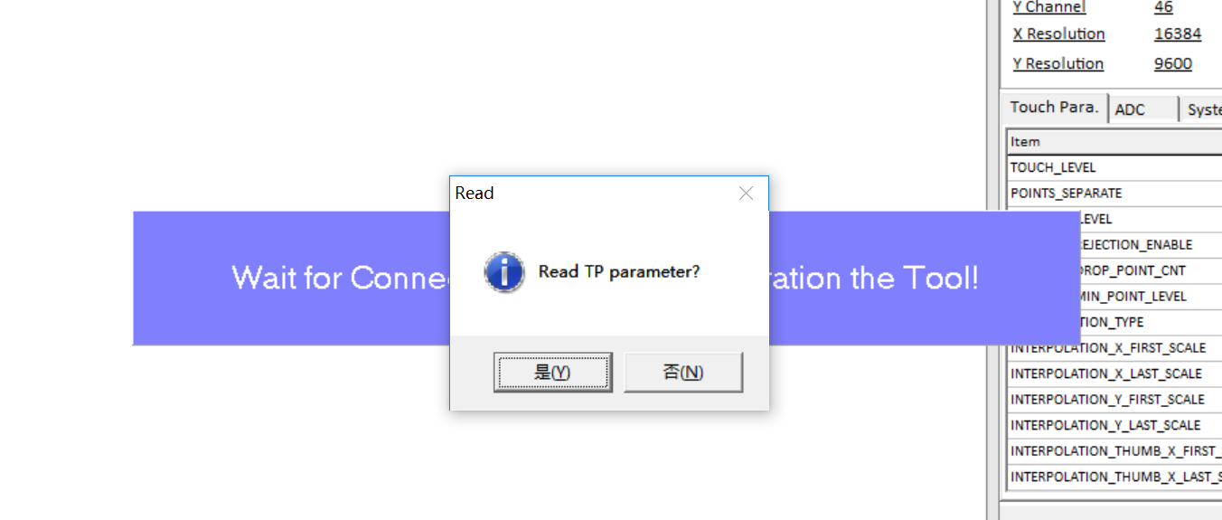
Connect the Controller with your PC, read all the parameters.

Slide 3
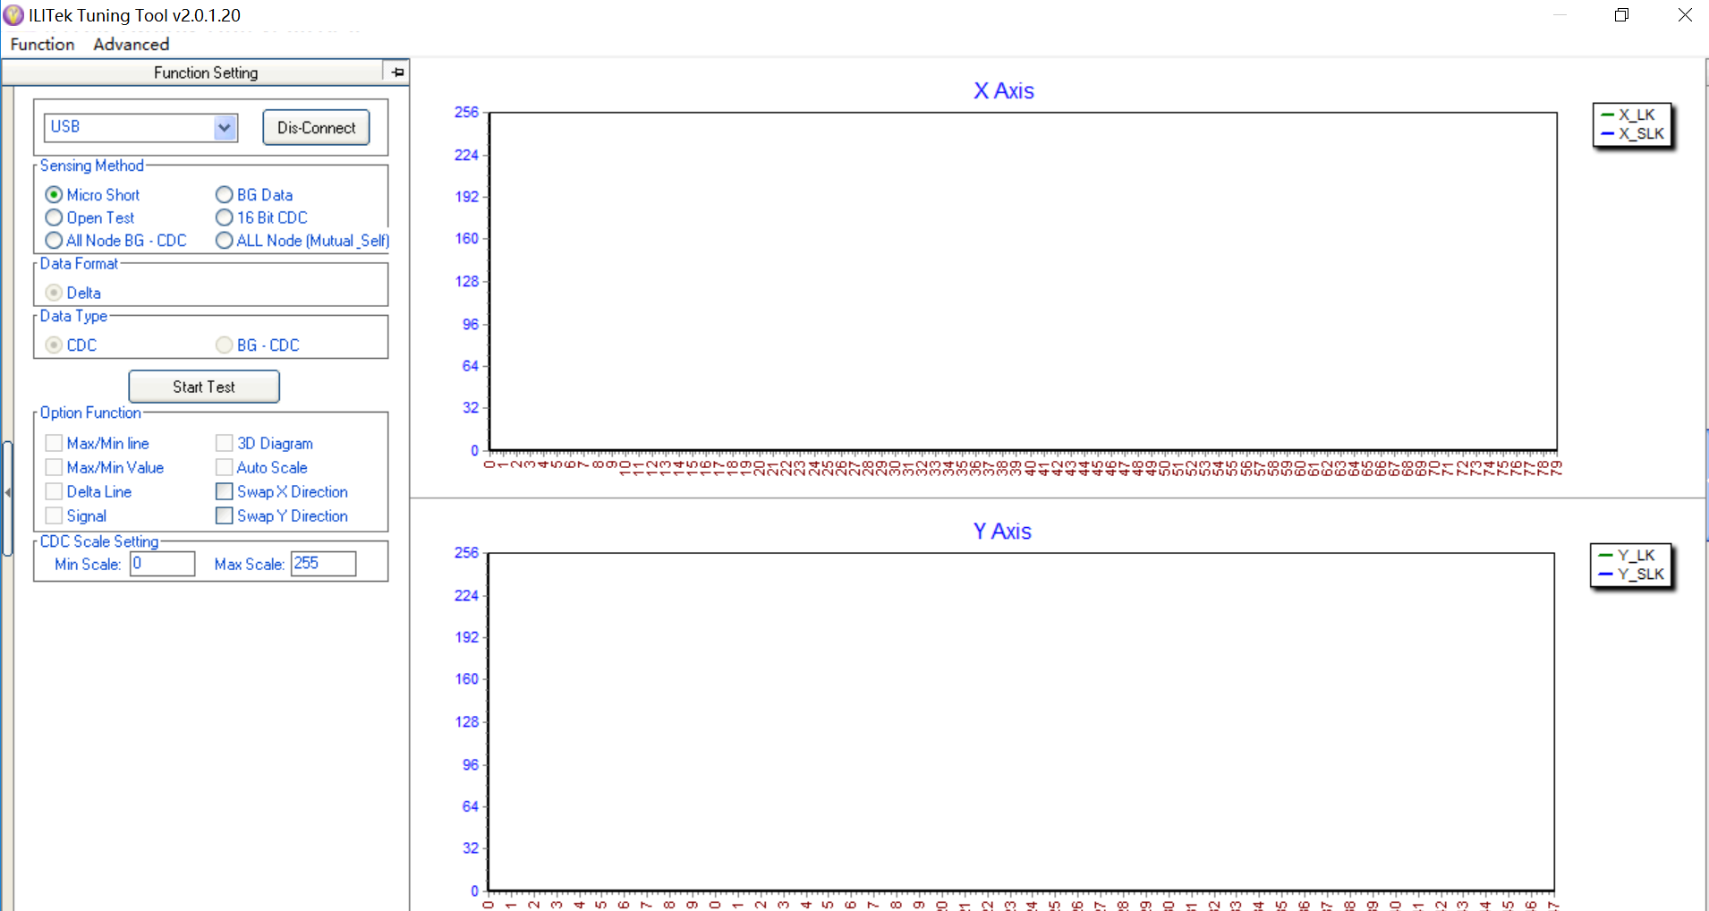
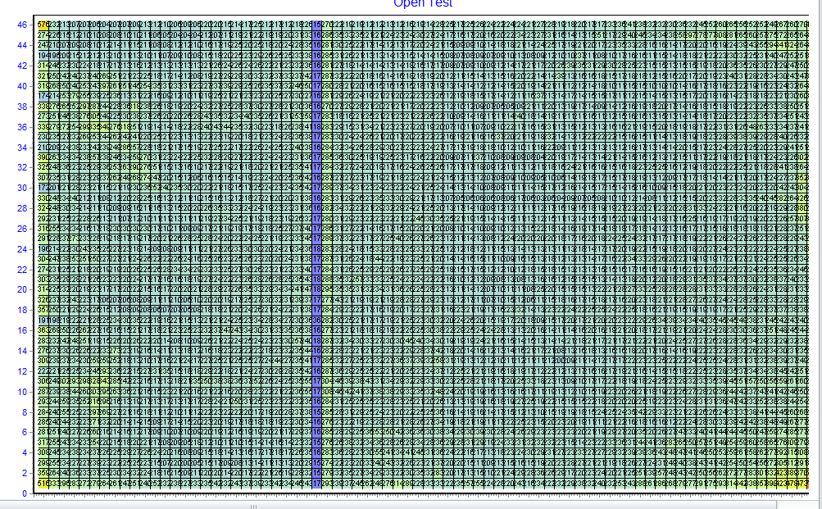
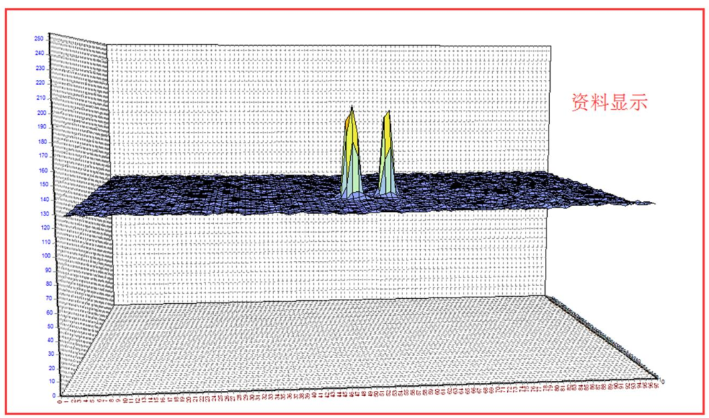
Short circuit test，If there is short circuit, it will show peaks, and the digits will be above 5, under normal status the digits will be 0~1
Open circuit test，If there is open circuit, there will be a dark blue line.
Dynamic signal check, will be a reference for noise and sensitivity reference.

Slide 4
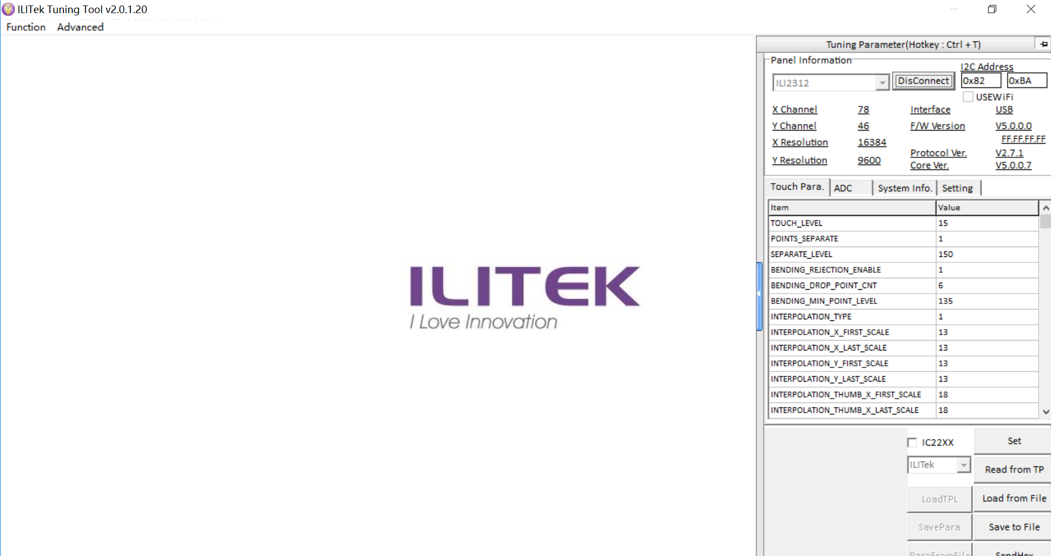
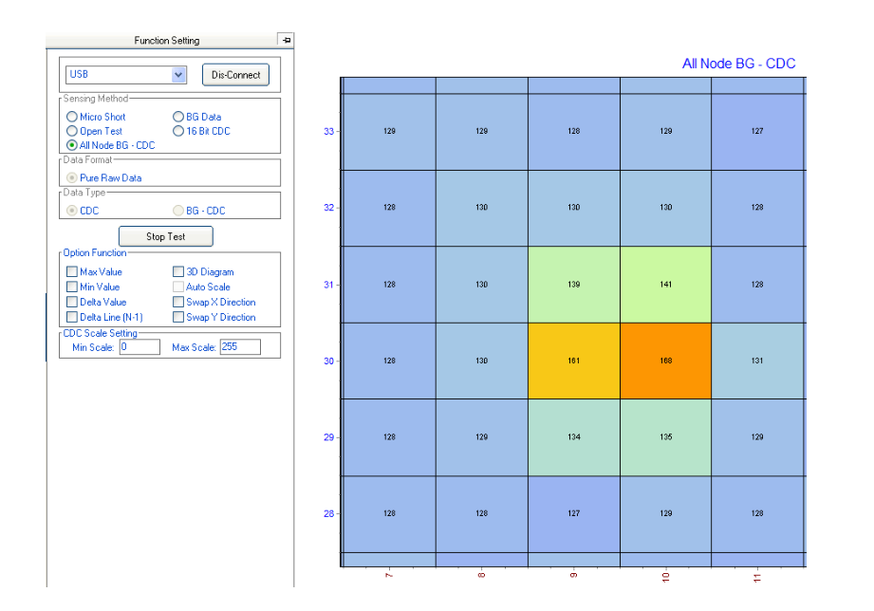

Conductivity Test

Slide 5
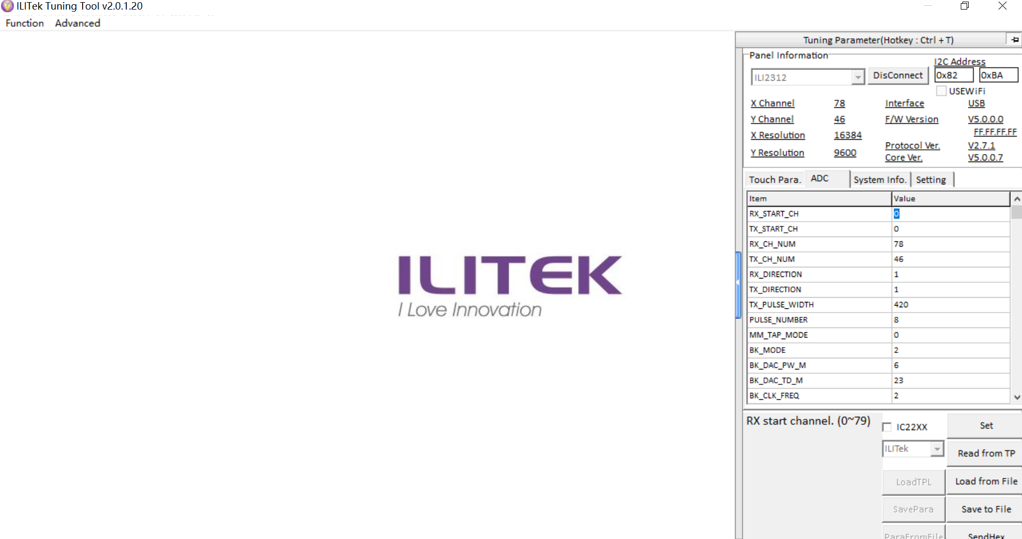
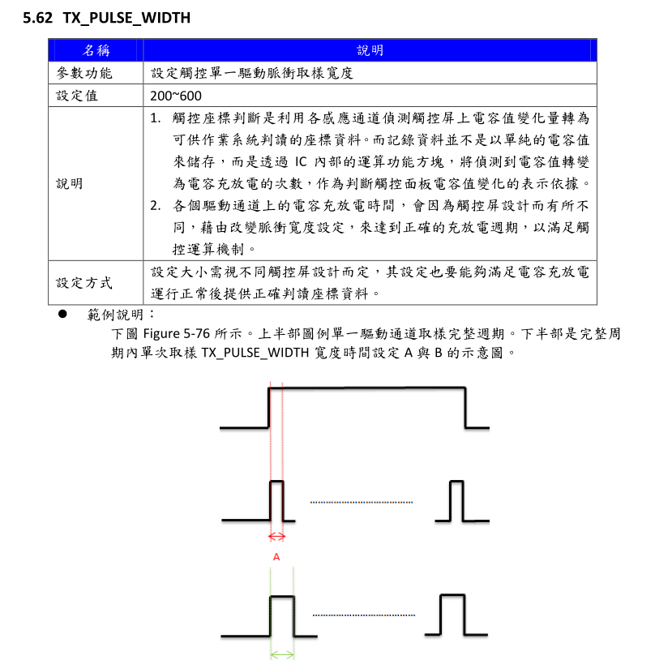

Slide 6
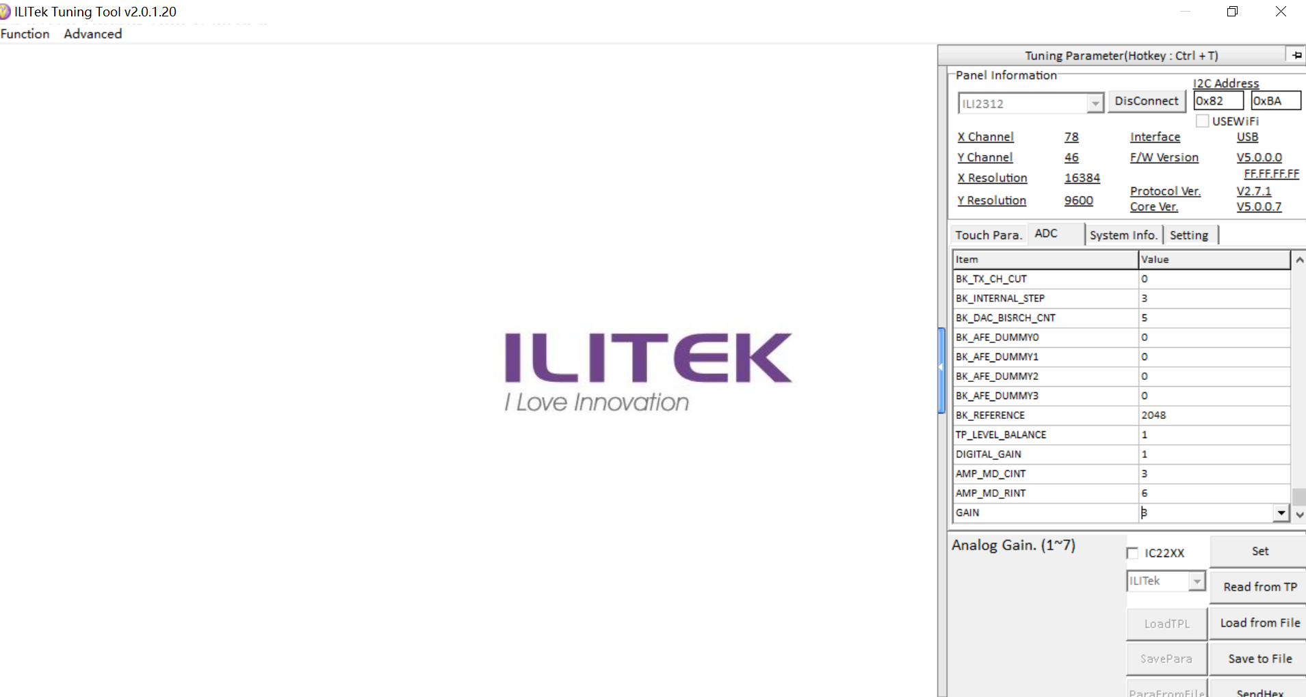
Signal index, value from 1~7，High digits shows high sensitivity as well as high noise level. Need to adjust accordingly to the environment.

Slide 7
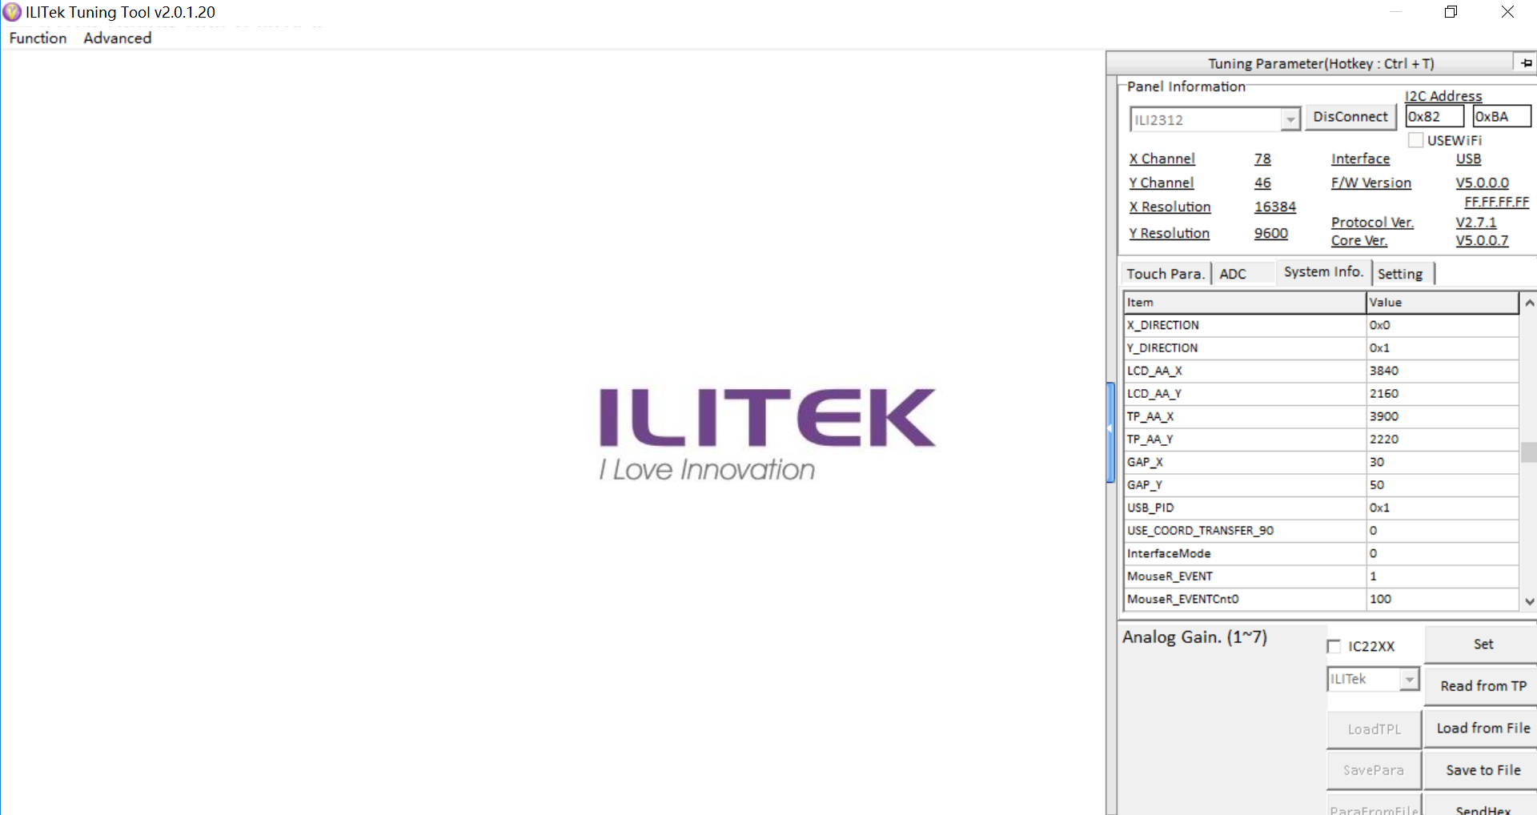
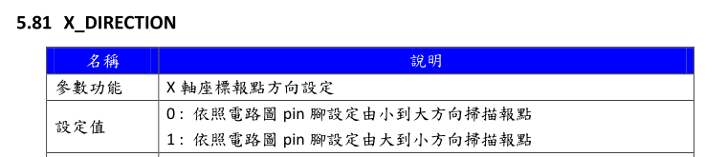
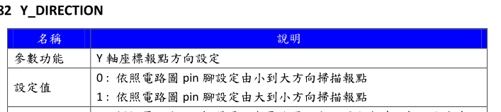
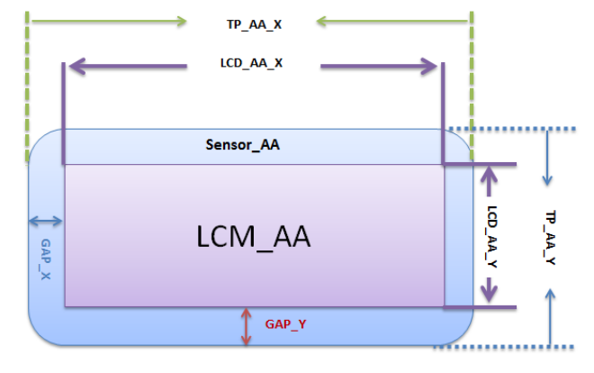
Direction change.

Slide 8
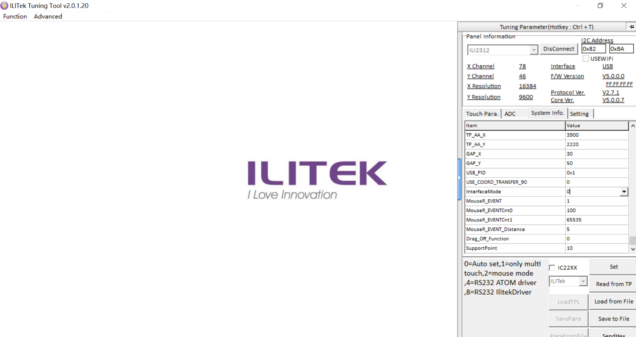
0=Auto set,1=only multi touch,2=mouse mode ,4=RS232 ATOM driver ,8=RS232 IlitekDriver
Touch points 1~10
Change the parameter and click “SET”, then it will write into the IC.

Slide 9
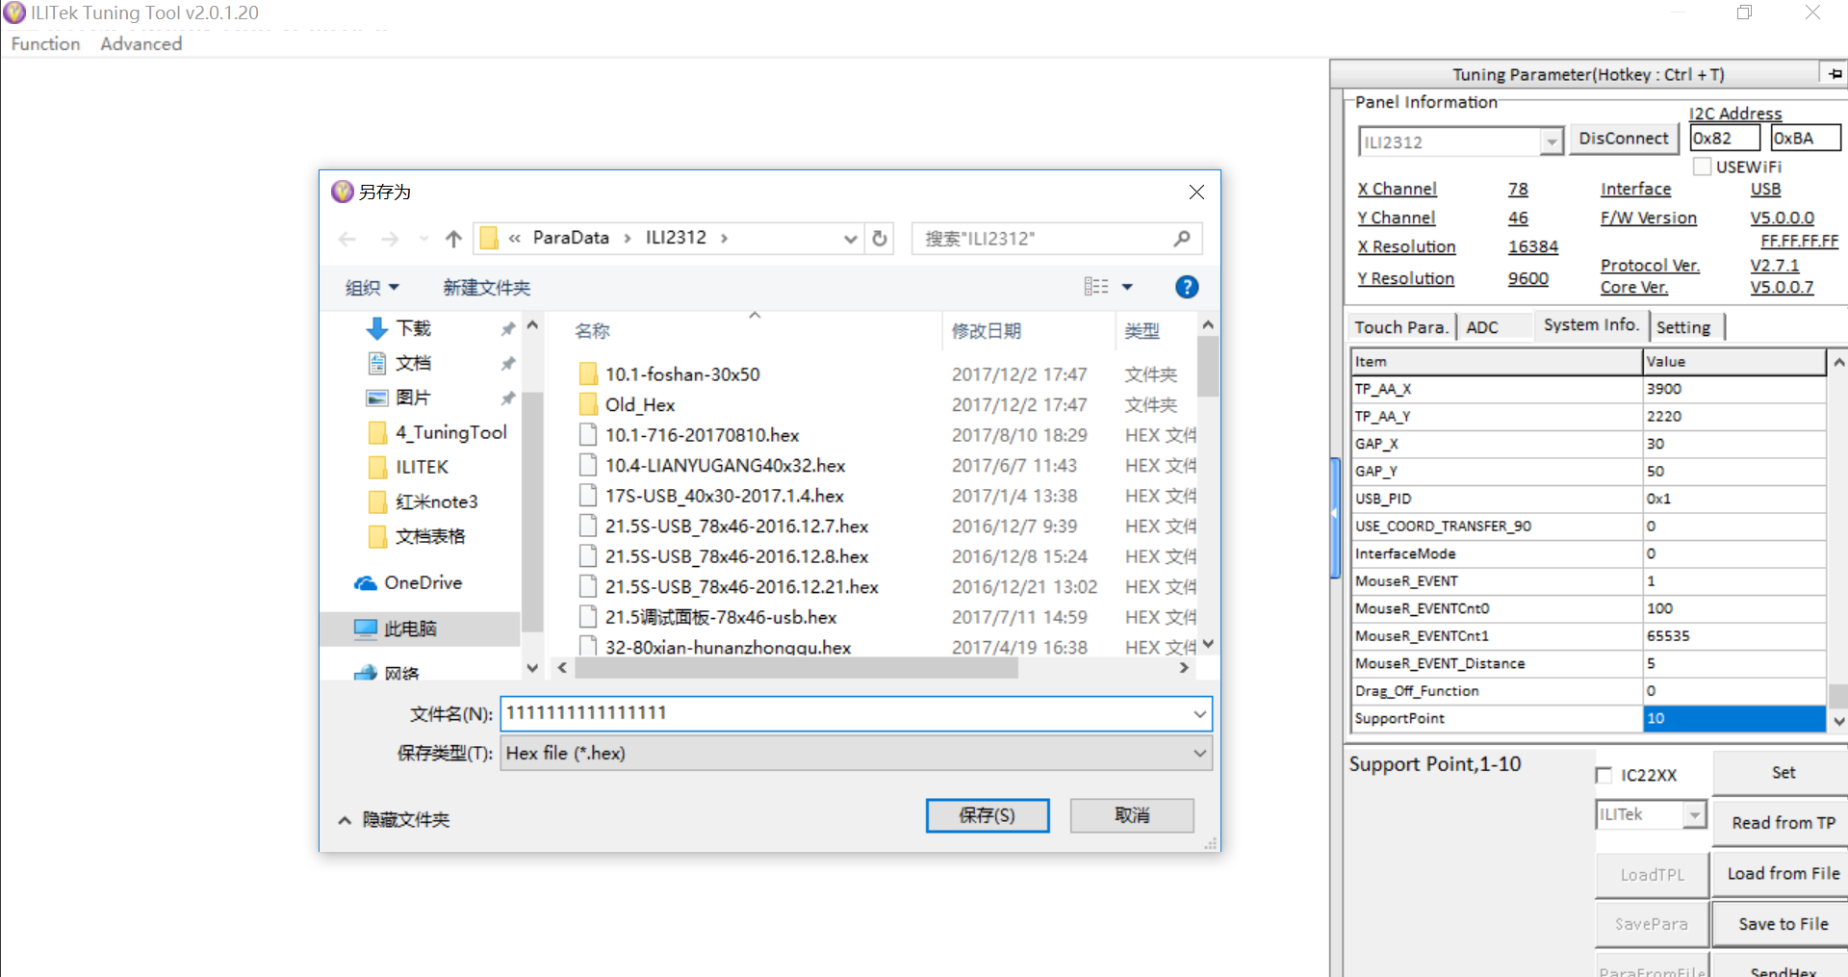
Save Firmware， save as HEX file

Slide 10
Thank You ！

