Slide 1

BH32LM
32”
500 cd/m² Module
Key Feature
1920 x 1080 Resolution
500nits
LVDS Interface
Screen Protection Tempered Glass
Fully Fit Module

Slide 2
Specification
Display
Screen Size (Diagonal) | 32 inch
Native Resolution | 1920 （H） x 1080(V)
Aspect Ratio | 16：9
Brightness（Module） | 500 cd/m²
View Angle | R/L 89°， U/D 89°
Backlight uniformity | 80%
Display Color | 16.7 M
Life Time (Light Source) | 30,000 Hrs（Min）
Touch
Touch Type | 10 Points Capacitive Touch
Touch Method | Finger
Touch Accuracy | ≤2mm
Interface for touch | USB Protocol
Voltage | 5V
Environment
Operation temperature | 0℃~50℃
Operation humidity | 20%~80% RH

Slide 3
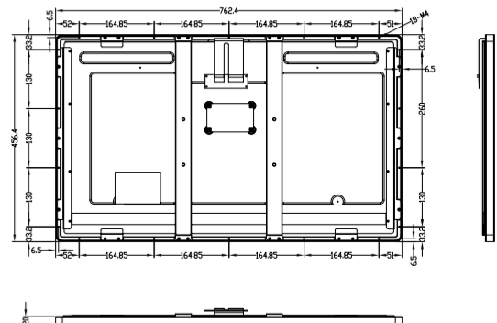
Specification
Physical
Color | Black
Tempered Glass | 3mm
Set Dimension | 762.4(L) ×456.4(W) × 22.8(H) mm
Set Weight | TBD
Package Dimension | TBD
Package Weight | TBD
Dimension Drawing
We may make changes to specifications and product descriptions without notice

